Slide 1
Appointment Maker: Pilot Review
September 26, 2012

Slide 2
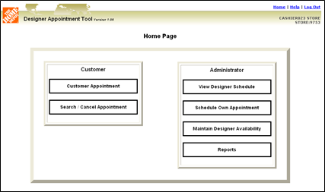
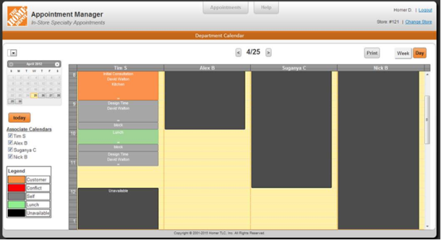
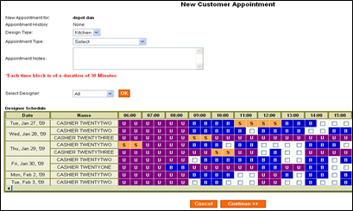
Appointment Maker – Existing versus Future
KDAT
Appointment Maker
Current State
Future State
D29 Designers only
FaST update weekly
Inclusion by LDAP group
Email appointment confirmation to Designer
Easy to use but often multiple screens
Appointment “Conflict” notification in KDAT
Online customer can make initial appointment
Horizontal timeline
Store reporting only
D23, D29, D30 and D59 Specialists, Designers, DSs (not D29), COS (if assigned to dept.)
FaST updates nightly
Inclusion by Job Code
ESVS Quote and Notes to assigned associate
Very easy to use – Outlook/Smart Phone like
Appointment “Conflict” notification in AM and ESVS
Online customer can make initial appointment
Vertical layout to timeline, shared calendars
Reporting at store, district, region, division and company level
Can manage schedules with “Week” view
Auto-blocked time first/last 30 minutes of shift and 15 minutes before/after lunch. Completely Editable.

Slide 3

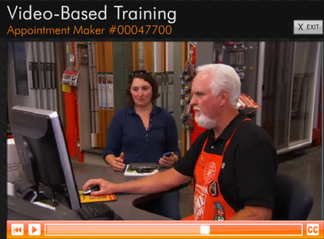
Appointment Maker – Information
Training
Learning Class WBT-00047700) found in Knowledge Depot (myApron > my Tool Box > Knowledge Depot)
15-Minutes
Overview of tool and process
Help Guide
Screen shots and FAQ’s – the “how to”
In WLM
Linked in the tool for easy reference
On myApron > mySuccess – myDepartment > Specialty – Training > Specialty: Appointment Maker Help Guide
Mouse rollover feature in tool
Our request to you
Cascade the message to DMs → SMs → SASMs → DSs → Specialists and Designers
Complete the Knowledge Depot class
Use the tool every day
Become familiar with it – make practice customer appointments, real customer appointments, real self-appointments
Move, adjust times, cancel practice appts.
Routinely look in ESVS for the quote and notes
DSs use as a management tool (weekly view) and to enter own self-appointments (staff meeting, etc.)
Opening MOD habit: call out = check for reschedule appointments and customers to call
Use the reporting
Follow-up frequently → Make it a part of stores DNA
Pilot Feedback
It is so easy to use
Our associates found it easy to use and easy to navigate with quick access to different screens
Love the content in the ESVS note
It is an easy way to follow up with appointments by capturing notes with the ESVS note
It is easy follow daily schedules of associates
Overall this has potential to be a great tool
Seeing the weekly shared calendar is a great management tool
It is a big win to be able to reassign an appointment to another associate (can drag appointment over and a note is created in ESVS for new associate)

Slide 4
Appointment Maker - Schedule & Next Steps
Next Steps
Launch Gatekeeper
Ensure RDO/DOMs receive training information
Ensure HR teams drive the training completion
WLM/myPlanner visible in all stores
Continue to monitor The Warehouse for feedback

